Slide 1

Chapter 4
Polymorphism in PHP (OOP)
ITP03 | 1ST SEMESTER

Slide 2
Learning Objectives
1. Explain and implement polymorphism using a common base class.

Slide 3
What is Polymorphism?
Polymorphism means one interface, many behaviors.
Different classes can implement the same method name but different function.
Achieved through method overriding.
Polymorphism = "Many Forms"

Slide 4
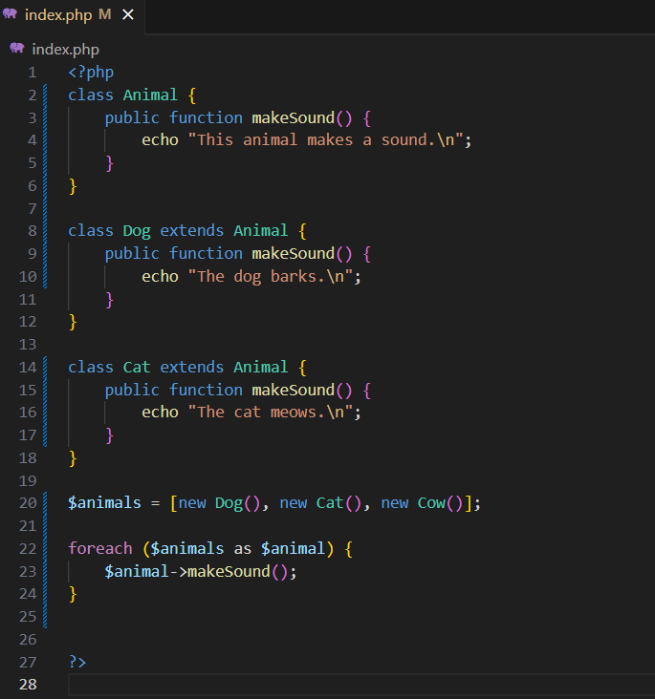
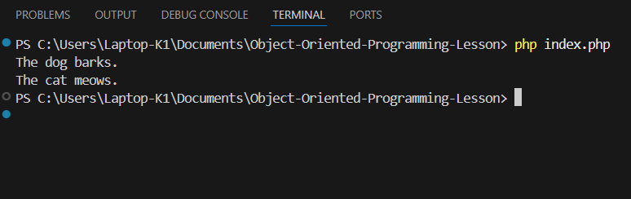
Syntax

Slide 5
Late Static Binding (static::)
Meaning: Late Static Binding means that when a static method or property is called in a parent class, PHP decides at runtime (not when the code is written) which class’s version should be used the parent’s or the child’s.
Why it’s called late? Because the decision about which method to call is made later (when the program runs), instead of early (when the code is defined).
In Simple Words: It lets a parent class use a method, but if a child overrides it, the child’s version will run even if the call is inside the parent.

Slide 6
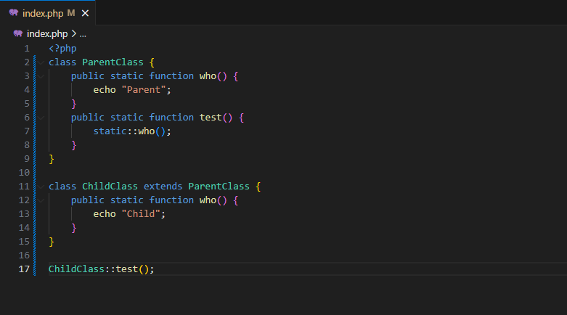
Example

